Slide 1
Data Presentations (1)
Md. Ismail Hossain Riday

Slide 2
What is Data Presentation
It is a process of organizing, summarizing, and visual representation of data
Which is easy to understandable and interpretable

Slide 3
What is Data Presentation
Case ID | Gender | Wealth Status | Education
01 | Male | Middle | No education
02 | Female | Middle | Primary
03 | Female | Poor | Primary
04 | Male | Rich | Higher
… | … | … | …
… | … | … | …
8000 | Male | Poor | No education

Slide 4
What is Data Presentation
Male
Female
Male | 56.3%
Female | 43.7%

Slide 5
How to present…
Frequency distribution
Graphical representation

Slide 6
Frequency distribution
It is a statistical tabulated representation process
of the number of occurrence
of each class/category
Arranging data into homogeneous/similar group

Slide 7
Frequency distribution
For example, collects blood group from 10 students,
O, A, B, O, AB, B, A, A, A, AB
How many homogeneous groups are there in this data?
O | 2
A | 4
B | 2
AB | 2
FREQUENCY

Slide 8
Class Work
Student, Student, Public service, Businessman, Day labor, Public service, Private service, Day labor, Student, Public service, Public service, Private service, Businessman, Day labor, Businessman, Private service, Businessman, Public service, Private service, Public service.
Businessman | 4
Day Labor | 3
Private service | 4
Public service | 6
Student | 3
Total | 20

Slide 9
Types of FD
Frequency distribution of Quantitative data
Frequency distribution of Qualitative data

Slide 10
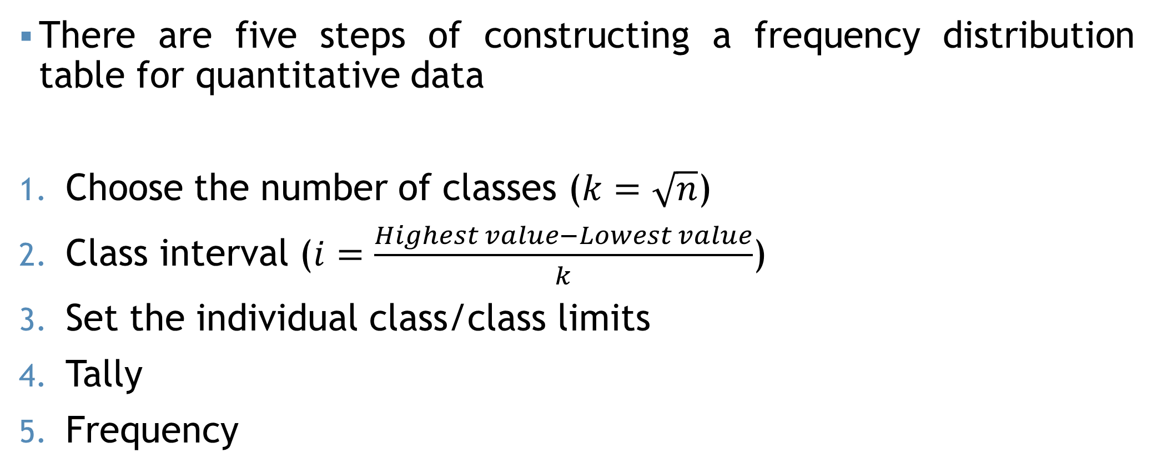
FD for Quantitative
There are five steps of constructing a frequency distribution table for quantitative data
Choose the number of classes ($k=\sqrt{n}$)
Class interval ($i=\frac{Highest value−Lowest value}{k}$)
Set the individual class/class limits
Tally
Frequency

Slide 11
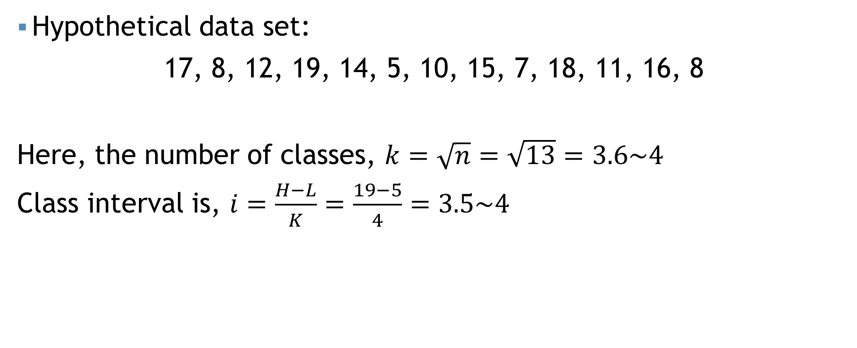
FD for Quantitative
Hypothetical data set:
17, 8, 12, 19, 14, 5, 10, 15, 7, 18, 11, 16, 8
Here, the number of classes, $k=\sqrt{n}=\sqrt{13}=3.6\sim 4$
Class interval is, $i=\frac{H−L}{K}=\frac{19−5}{4}=3.5\sim 4$
Class | Tally | Frequency
5-9 | |||| | 4
9-13 | ||| | 3
13-17 | ||| | 3
17-21 | ||| | 3

Slide 12
Class Work
Below given the total monthly income (in thousand taka) of 30 randomly selected families-
30, 40, 5, 110, 11, 15, 55, 20, 120, 45, 30, 47, 52, 68, 105, 62, 52, 98, 76, 85, 83, 91, 49, 38, 57, 27, 23, 42, 9, 65

Slide 13
FD for Quantitative
Class | Tally | Frequency
5-9 | |||| | 4
9-13 | ||| | 3
13-17 | ||| | 3
17-21 | ||| | 3

Slide 14
FD for Quantitative
Class | Tally | Frequency | Relative frequency
5-9 | |||| | 4
9-13 | ||| | 3
13-17 | ||| | 3
17-21 | ||| | 3

Slide 15
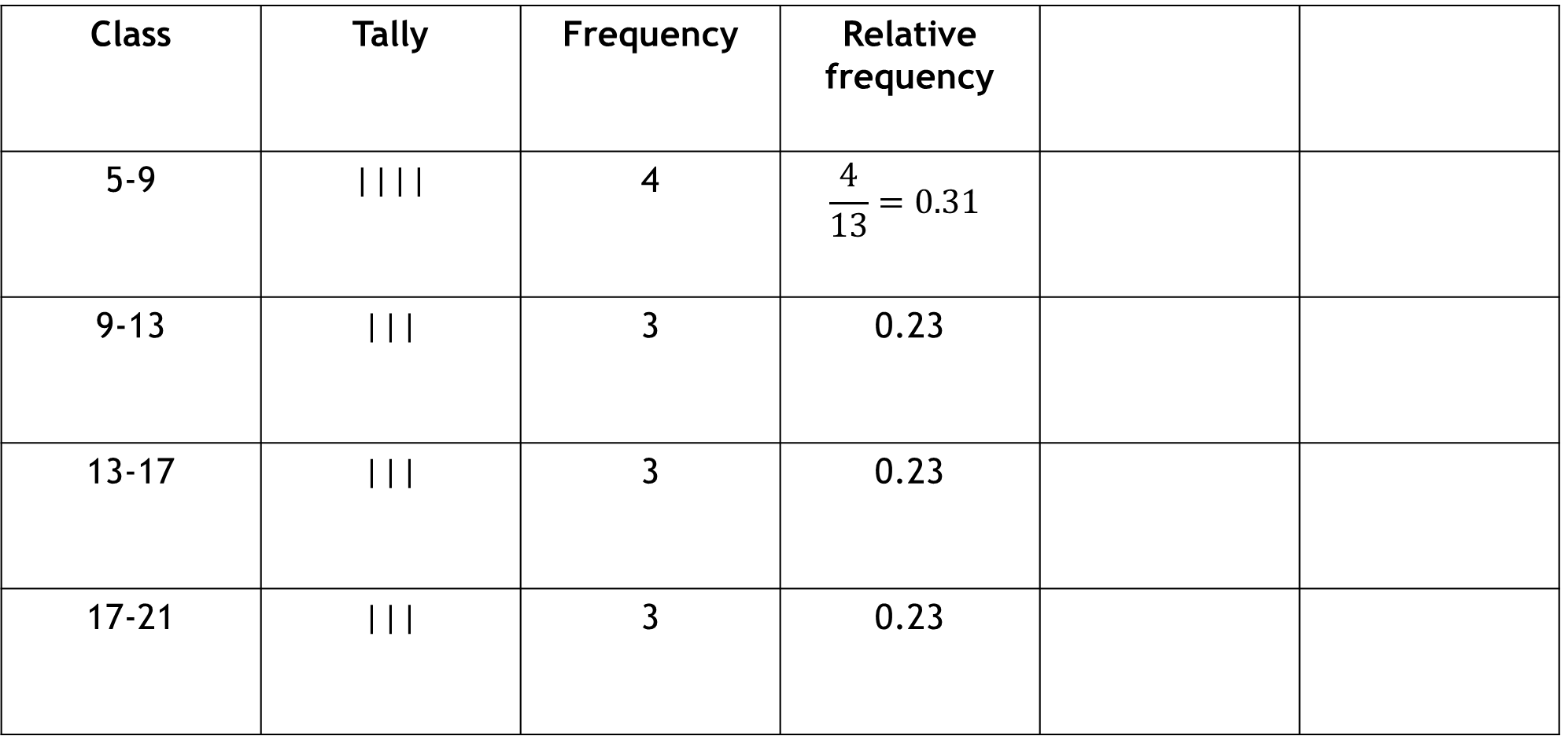
FD for Quantitative
Class | Tally | Frequency | Relative frequency
5-9 | |||| | 4 | $$\frac{4}{13}=0.31$$
9-13 | ||| | 3 | 0.23
13-17 | ||| | 3 | 0.23
17-21 | ||| | 3 | 0.23

Slide 16
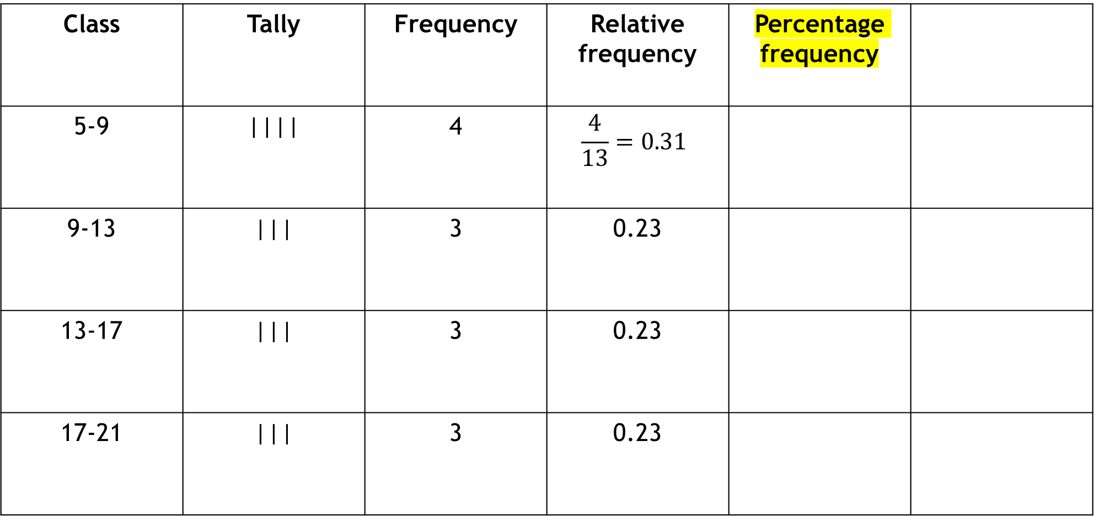
FD for Quantitative
Class | Tally | Frequency | Relative frequency | Percentage frequency
5-9 | |||| | 4 | $$\frac{4}{13}=0.31$$
9-13 | ||| | 3 | 0.23
13-17 | ||| | 3 | 0.23
17-21 | ||| | 3 | 0.23

Slide 17
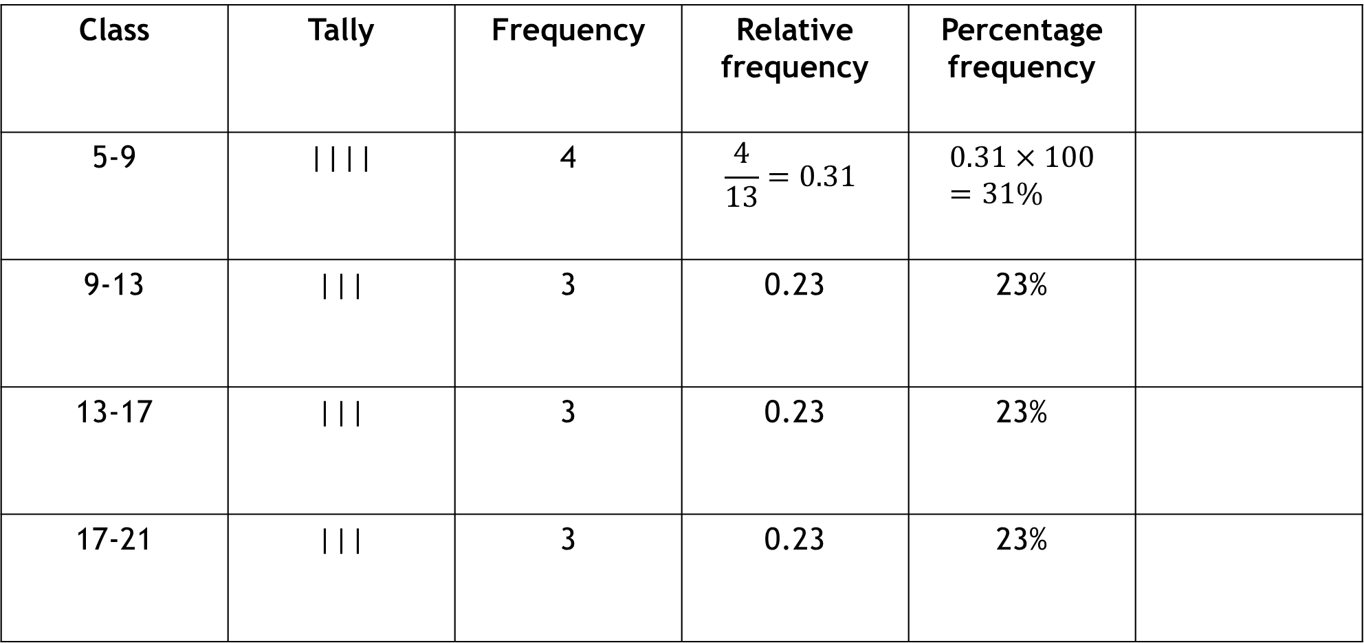
FD for Quantitative
Class | Tally | Frequency | Relative frequency | Percentage frequency
5-9 | |||| | 4 | $$\frac{4}{13}=0.31$$ | $$0.31×100=31\%$$
9-13 | ||| | 3 | 0.23 | 23%
13-17 | ||| | 3 | 0.23 | 23%
17-21 | ||| | 3 | 0.23 | 23%

Slide 18
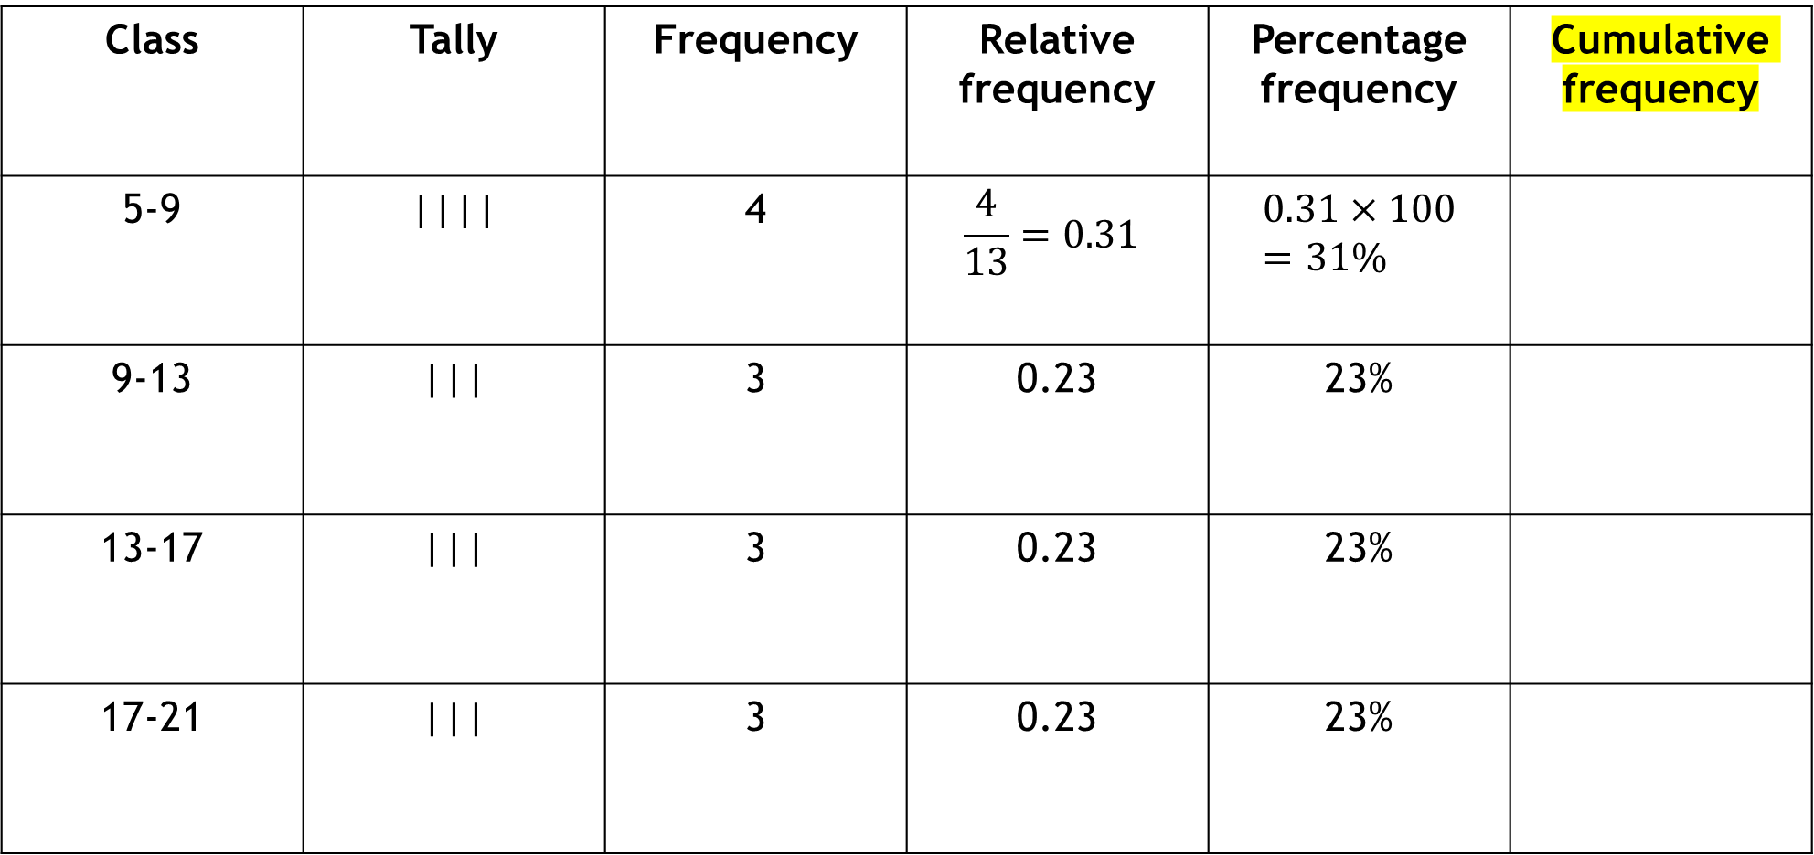
FD for Quantitative
Class | Tally | Frequency | Relative frequency | Percentage frequency | Cumulative frequency
5-9 | |||| | 4 | $$\frac{4}{13}=0.31$$ | $$0.31×100=31\%$$
9-13 | ||| | 3 | 0.23 | 23%
13-17 | ||| | 3 | 0.23 | 23%
17-21 | ||| | 3 | 0.23 | 23%

Slide 19
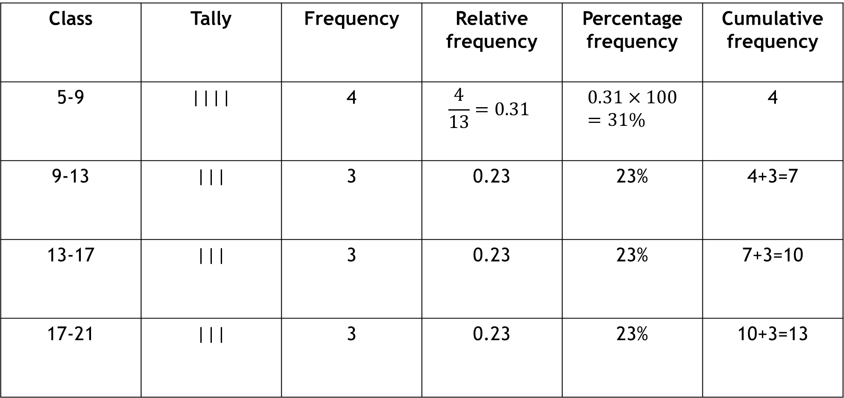
FD for Quantitative
Class | Tally | Frequency | Relative frequency | Percentage frequency | Cumulative frequency
5-9 | |||| | 4 | $$\frac{4}{13}=0.31$$ | $$0.31×100=31\%$$ | 4
9-13 | ||| | 3 | 0.23 | 23% | 4+3=7
13-17 | ||| | 3 | 0.23 | 23% | 7+3=10
17-21 | ||| | 3 | 0.23 | 23% | 10+3=13

Slide 20
Class Work
Weight (in KG) | Midpoint | Frequency | Relative frequency | Cumulative frequency | Relative Cumulative freq.
35-40 | 37.5 | 2 | 0.033
40-45 |  | 5 | 0.083
45-50 | 47.5 | 12
50-55 |  |  |  | 35
55-60 |  | 12
60-65 |  | 6
65-70 |  | 4
70-75 |  | 3 | 0.050

Slide 21
FD for Qualitative
Student, Student, Public service, Businessman, Day labor, Public service, Private service, Day labor, Student, Public service, Public service, Private service, Businessman, Day labor, Businessman, Private service, Businessman, Public service, Private service, Public service.
Class | Tally | Frequency
Businessman | |||| | 4
Day Labor | ||| | 3
Private service | |||| | 4
Public service | |||| | 6
Student | ||| | 3
Total |  | 20

Slide 22
Mathematical exercise
To access additional mathematical problems, please refer to the PDF lecture notes.

Slide 23
Thank You

